Slide 1
CMMI Overview
Satish Mishra
11 -02- 2005

Slide 2


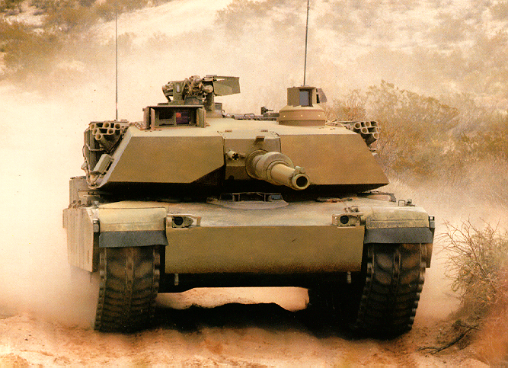
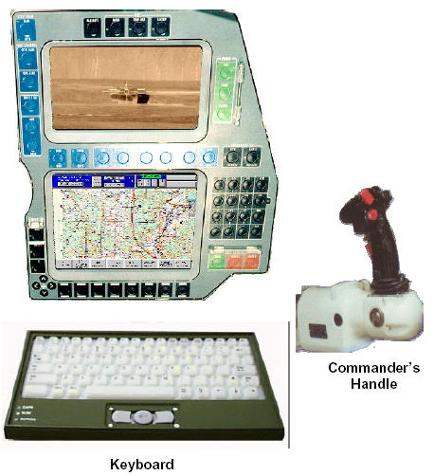
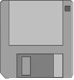
Focus of CMMI
CMMI is applied here
SW-CMM is applied here

Slide 3
Quality Leverage Points
Everyone realizes the importance of having a motivated, quality work force but...
PEOPLE
...even our finest people can’t perform at their best when the process is not understood or operating
“at its best.”
TECHNOLOGY
PROCESS
Major determinants of product cost, schedule, and quality
Notes:
See notes on slide 5

Slide 4
Why Focus on Process?
Process provides a constructive, high-leverage focus...
  as opposed to a focus on people
    Your work force, on the average, is as “good” as it is trained to be.
    Working harder is not the answer.
    Working smarter, through process, is the answer.
  as opposed to a focus on technology
    Technology applied without a suitable roadmap will not result in significant payoff.
    Technology provides the most benefit in the context of an appropriate process roadmap.
Notes:
See notes on slide 5

Slide 5
Underlying Premise of Process Improvement
“The quality of a product is largely determined by the quality of the process that is used to develop and maintain it.”

Slide 6
Categories of Process Improvement Benefits
Process improvement benefits fall into eight general categories:
  improved schedule and budget predictability
  improved cycle time
  increased productivity
  improved quality (as measured by defects)
  increased customer satisfaction
  improved employee morale
  increased return on investment
  decreased cost of quality
Notes:
See notes on page 11

Slide 7
What is a CMM?
Capability Maturity Model:
A reference model of mature practices in a specified discipline, used to assess a group’s capability to perform that discipline
CMMs differ by
  Discipline (software, systems, acquisition, etc.)
  Structure (staged versus continuous)
  How Maturity is Defined (process improvement path)
  How Capability is Defined (institutionalization)

Slide 8
So Many Models, So Little Time
EIA 731
Different structures, formats, terms, ways of measuring maturity
Causes confusion, especially when using more than one model
Hard to integrate them in a combined improvement program
Hard to use multiple models in supplier selection
Software
CMM
Systems
Engr
CMM
People
CMM
IPD
CMM
Software
Acq
CMM
Systems
Security
Engr CMM

Slide 9
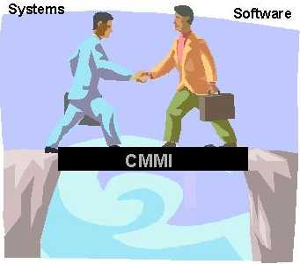
Bridging the Divide
CMMI:
Integrates systems and software disciplines into one process improvement framework.
Provides a framework for introducing new disciplines as needs arise.

Slide 10
The Next Step Is CMM Integration
The CMM Integration Project was formed to
  build an initial set of integrated models
  improve best practices from source models based on lessons learned
  establish a framework to enable integration of future models
  create an associated set of appraisal and training products
Collaborative endeavor (over 100 people involved)
  Industry
  Government
  Software Engineering Institute (SEI)

Slide 11
Enterprise-Wide Improvement
CMMI enables organizations that want to pursue process improvement in multiple functional areas to do so with less additional investment for each additional function.
  CMMI supports process integration and product improvement.
  CMMI integrates multiple disciplines into one process-improvement framework.
  CMMI provides a framework for introducing new disciplines as needs arise.

Slide 12
Bodies of Knowledge Captured in CMMI Models
An organization selects the bodies of knowledge most relevant to achieving its business objectives. Bodies of knowledge* available in CMMI models include
  software engineering(sw)
  systems engineering(se)
  integrated product and process development (IPPD)
  supplier sourcing (SS)
*Each body of knowledge related to product or process development in CMMI is considered a discipline.

Slide 13
Software Engineering (SW)
SW covers the development of software systems
SW focus on applying systematic, disciplined, and quantifiable approaches to the
  development,
  operation
  maintenance

Slide 14
System Engineering (SE)
Systems engineering covers the development of total systems, which may or may not include software
Systems engineers focus on transforming customer needs, expectations, and constraints into product solutions and supporting these product solutions throughout the life of the product

Slide 15
Integrated Product & process development (IPPD)
IPPD is a systematic approach that achieves a timely collaboration of relevant stakeholders throughout the life of the product to better satisfy customer needs, expectations, and requirements

Slide 16
Supplier sourcing (SS)
As work efforts become more complex, projects may use suppliers to perform functions or add modifications to products that are specifically needed by the project. When those activities are critical, the project benefits from enhanced source analysis and from monitoring supplier activities before product delivery

Slide 17
CMMI Models
Source Models
Capability Maturity Model for Software V2, draft C (SW-CMM V2C)
EIA Interim Standard 731, System Engineering Capability Model (SECM)
Integrated Product Development Capability Maturity Model, draft V0.98 (IPD-CMM)
CMMI-SE/SW
Staged
Representation
CMMI-SE/SW
Continuous
Representation
Combined System Engineering / Software Engineering model
Can be applied to:
  Just the software engineering projects in an organization
  Just the system engineering projects in an organization
  Both
  IPPD/SS can be used in either/both

Slide 18
Understanding CMMI Representations
There are two types of representations in the CMMI models:
  staged
  continuous
A representation allows an organization to pursue different improvement objectives
The organization and presentation of the data are different in each representation. However, the content is the same.

Slide 19
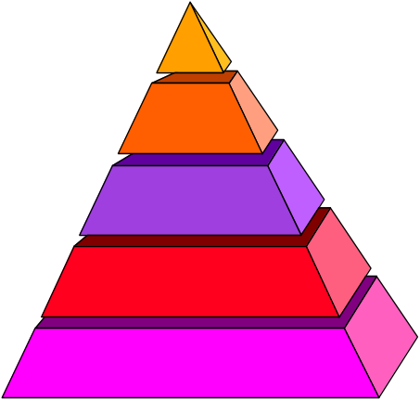
Staged Representation
Provides a proven sequence of improvements, each serving as a foundation for the next
Permits comparisons across and among organizations by the use of maturity levels
Provides an easy migration from the SW-CMM to CMMI
Provides a single rating that summarizes appraisal results and allows comparisons among organizations
Indicates maturity of an organization’s standard process -- to answer, “What is a good order for approaching improvement across the organization?”

Slide 20
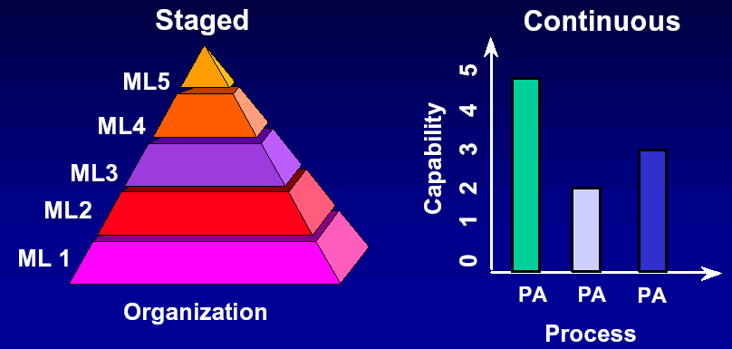
CMMI Model Representations

Slide 21
Maturity Levels
A maturity level is a well-defined evolutionary plateau of process improvement.
There are five maturity levels.
Each level is a layer in the foundation for continuous process improvement using a proven sequence of improvements, beginning with basic management practices and progressing through a predefined and proven path of successive levels.

Slide 22
The Maturity Levels
Optimizing
Optimizing
5
Focus on continuous process improvement
Quantitatively
Managed
4
Process measured
and controlled
Defined
Defined
3
Process characterized for the organization and is proactive
Managed
2
Process characterized for projects and is often reactive
Initial
1
Process unpredictable, poorly controlled, and
reactive

Slide 23
Maturity Levels Should Not
Be Skipped
Each maturity level provides a necessary foundation for effective implementation of processes at the next level.
  Higher level processes have less chance of success without the discipline provided by lower levels.
  The effect of innovation can be obscured in a
  noisy process.
Higher maturity level processes may be performed by organizations at lower maturity levels, with the risk of not being consistently applied in a crisis.

Slide 24

Continuous Representation
Allows you to select the order of improvement that best meets your organization’s business objectives and mitigates your organization’s areas of risk
Enables comparisons across and among organizations on a process-area-by-process-area basis
Provides an easy migration from EIA 731 (and other models with a continuous representation) to CMMI
Indicates improvement within a single process area -- to answer, “What is a good order for approaching improvement of this process area?”

Slide 25
Capability Levels
A capability level is a well-defined evolutionary plateau describing the organization’s capability relative to a process area.
There are six capability levels.
For capability levels 1-5, there is an associated generic goal.
Each level is a layer in the foundation for continuous process improvement.
Thus, capability levels are cumulative, i.e., a higher capability level includes the attributes of the lower levels.

Slide 26
The Capability Levels
5 Optimizing
4 Quantitatively Managed
3 Defined
2 Managed
1 Performed
0 Incomplete

Slide 27
Representing Capability Levels for a Single Process Area
The process area capability of an implemented process can be represented by a bar.
3
2
1
0
This point
represents
a higher level
of “maturity”
than this point
in a specific
process area
Capability Level
Process Area n
Process

Slide 28
Relating Process Area Capability and Organizational Maturity
Organizational maturity is the focus of the staged representation, whereas process area capability is the focus of the continuous representation.
Organizational maturity and process area capability are similar concepts.
The difference between them is that organizational maturity pertains to a set of process areas across an organization, while process area capability deals with a set of processes relating to a single process area or specific practice.

Slide 29
Comparison of Representations
Staged Continuous
Process improvement is measured using maturity levels.
Maturity level is the degree of process improvement across a predefined set of process areas.
Organizational maturity pertains to the “maturity” of a set of processes across an organization
Process improvement is measured using capability levels.
Capability level is the achievement of process improvement within an individual process area.
Process area capability pertains to the “maturity” of a particular process across an organization.

Slide 30
Advantages of Each Representation
Staged
Provides a roadmap for implementing
  groups of process areas
  sequencing of implementation
Familiar structure for those transitioning from the
Software CMM
Continuous
Provides maximum flexibility for focusing on specific process areas according to business goals and objectives
Familiar structure for those transitioning from EIA 731

Slide 31
CMMI in a Nutshell
A CMMI model provides a structured view of process improvement across an organization
CMMI can help
  set process improvement goals and priorities
  provide guidance for quality processes
  provide a yardstick for appraising current practices

Slide 32
Improvements from Adopting
Software CMM
Savings vs. cost of software process improvement (median) 5:1
39%
40
35%
35
30
25
19%
Productivity
(increase)
20
Percentage Improvement
15
Time to market
(reduction)
10
5
Post-release
defect reports
(reduction)
0
Annual Medians

Slide 33
Benefits of Continuing Process
Improvement
SEI Software CMM Level 5: For the Right Reasons*
  Defects are now nearly all found and fixed before
  testing begins.
  Defects escaping into the field have been reduced
  from 11% to practically 0%.
  Programs consistently reach customer satisfaction
  and performance targets.
  Peer reviews increase total project costs by 4%,
  but reduced rework during testing by 31%.
  R.O.I. is 7.75:1.

Slide 34
CMM“I” – Improvement
The CMMI Product Suite provides a foundation for enterprise-wide improvement and adds
  new emphasis on products and services as well
  as process
  emphasis on both process capability and
  organizational maturity
  early emphasis on measurement and analysis
The CMMI model improves upon Software CMM V1.1 and Software CMM V2.0 Draft C.

Slide 35
CMM“I” – Integration
Provides expanded model scope for integration
  Integrated Product Management
  Integrated Supplier Management
  Decision Analysis and Resolution
  “Relevant Stakeholder” planning and execution
  Inclusion of the Integrated Product and Process Development body of knowledge

Slide 36
Improving on the Software CMM
CMMI Models improve on the best practices in Software CMM Version 2.0 Draft C:
  Incorporates 4+ additional years of learning
  More explicitly links management and engineering activities to business objectives
  Expands the scope of and visibility into the product life cycle and engineering activities to ensure the product or service meets customer expectations
  Incorporates additional areas of best practice (e.g., measurement, risk management, bi-directional traceability in requirements management, decision analysis and resolution, and supplier management)
  Captures more robust high-maturity practices
  Addresses additional generic practices needed for institutionalization
  More fully complies with relevant ISO standards

Slide 37
CMMI Can Benefit You
CMMI provides
  Efficient, effective assessment and improvement across multiple process disciplines in an organization
  Improvements to best practices incorporated from the Software CMM
  A common, integrated vision of improvement for all elements of an organization
  A means of representing new discipline-specific information in a standard, proven process-improvement context

Slide 38
CMMI Product Suite
Models
  Disciplines
    Systems Engineering SE
    Software Engineering SW
    Integrated Product and Process Development (IPPD)
    Supplier Sourcing (SS)
  Representations
    Staged
    Continuous

Slide 39
Available Models
The following CMMI Models exist:
  SE/SW Staged
  SE/SW Continuous
  SE/SW/IPPD Staged
  SE/SW/IPPD Continuous
  SE/SW/IPPD/SS Staged
  SE/SW/IPPD/SS Continuous
  SW Staged
  SW Continuous

Slide 40

Selecting a Discipline to Use
Different model versions exist
  CMMI-SW -- CMMI-SE/SW/IPPD
  CMMI-SE/SW -- CMMI-SE/SW/IPPD/SS
You select which disciplines you wish to use, based on where you are trying to improve
Example – A company which engineers and builds computer systems, by acquisition of COTS hardware and development of custom software, using integrated teams
  Use CMMI-SW applied only to the software development
  Use CMMI-SE/SW applied to the computer system and the software
  Use CMMI-SE/SW/IPPD applied to the system, software, and use of teams
  Use CMMI-SE/SW/IPPD applied to the system, software, teams, and COTS acquisition

Slide 41
CMMI Structure one Model, Two Representations
Appendixes
Appendixes
Maturity Level 5
OID, CAR
Support
CM, PPQA, MA,
CAR, DAR
Maturity Level 4
OPP, QPM
Engineering
REQM, REQD, TS,
PI, VER, VAL
Maturity Level 3
REQD, TS, PI, VER,
VAL, OPF, OPD, OT,
IPM, RSKM, DAR
Project Management
PP, PMC, SAM
IPM, RSKM, QPM
Maturity Level 2
REQM, PP, PMC,
SAM, MA, PPQA, CM
Process Management
OPF, OPD, OT,
OPP, OID
Overview
Introduction
Structure of the Model
Model Terminology
Maturity Levels, Common Features, and Generic Practices
Understanding the Model
Using the Model
Overview
Introduction
Structure of the Model
Model Terminology
Capability Levels and Generic Model Components
Understanding the Model
Using the Model
Process Management
PAs
- Goals
- Practices
CMMI-SE/SW
Staged
CMMI-SE/SW
Continuous

Slide 42
Model Components
Process Areas (PA)
  Specific Goals (SG) Required
    Specific Practices (SP) Expected
      Typical Work Products Informative
      Sub-practices Informative
      Notes Informative
      Discipline Amplifications Informative
      References Informative
  Generic Goals (GG) Required
    Generic Practices (GP) Expected
      Generic Practice Elaborations Informative

Slide 43

Practices
Practices are the building blocks of the process areas
Example - Project Planning Process Area
  Specific Practice 1.1 - Establish a top-level work breakdown structure (WBS) to estimate the scope of the project.
To satisfy the required goals, you are expected to perform the practices
  Most commercial and defense projects/organizations will implement as written
You may perform equivalent practices if they have an equivalent effect toward satisfying the generic or specific goal
  These are termed “alternative practices”
  Less prevalent in CMMI than in SW-CMM, because the CMMI practices are at a slightly higher level of abstraction
  “Equivalent” is a judgment call – discuss with your appraiser

Slide 44
Specific Practices vs. Generic Practices
Apply to a single process area
Describe activities that implement the process area
Example – Requirements Mgmt.
SG 1 Manage Requirements
  SP 1.1 Obtain an Understanding of Requirements
  SP 1.2 Obtain Commitment to Requirements
  SP 1.3 Manage Requirements Changes
  SP 1.4 Maintain Bidirectional Traceability of Requirements
  SP 1.5 Identify Inconsistencies between Project Work and Requirements
Apply to all process areas
Describe activities that institutionalize the process areas
GG 2 Institutionalize a Managed Process
  GP 2.1 Establish an Organizational Policy
  GP 2.2 Plan the Process
  GP 2.3 Provide Resources
  GP 2.4 Assign Responsibility
  GP 2.5 Train People
  GP 2.6 Manage Configurations
  GP 2.7 Identify and Involve Relevant Stakeholders
  GP 2.8 Monitor and Control the Process
  GP 2.9 Objectively Evaluate Adherence
  GP 2.10 Review Status with Higher Level Management
GG 3 Institutionalize a Defined Process
  GP 3.1 Establish a Defined Process
  GP 3.2 Collect Improvement Information

Slide 45
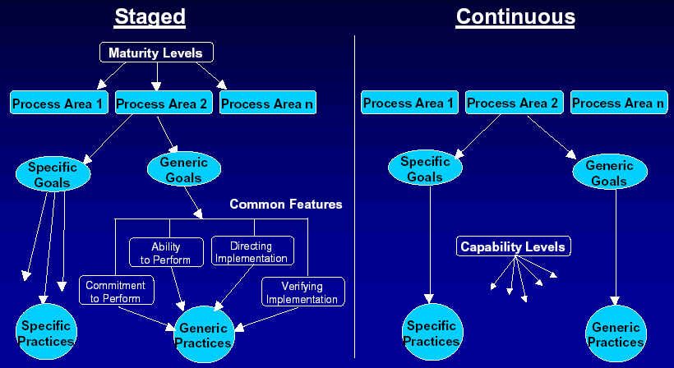
CMMI Model Structure

Slide 46
Staged Representation:
Process Areas by Maturity Level
Level
Focus
Process Areas
Continuous
Organizational Innovation and Deployment
Causal Analysis and Resolution
5 Optimizing
process
improvement
4 Quantitatively
Managed
Quantitative
management
Organizational Process Performance
Quantitative Project Management
Requirements Development
Technical Solution
Product Integration
Verification
Validation
Organizational Process Focus
Organizational Process Definition
Organizational Training
Integrated Project Management
Integrated Supplier Management
Risk Management
Decision Analysis and Resolution
Organizational Environment for Integration
Integrated Teaming
3 Defined
Process
standardization
(SS)
(IPPD)
(IPPD)
Basic
project
management
Requirements Management
Project Planning
Project Monitoring and Control
Supplier Agreement Management
Measurement and Analysis
Process and Product Quality Assurance
Configuration Management
2 Managed
1 Initial

Slide 47
Continuous Representation:
Organization of Process Areas
Category
Process Area
Project Planning
Project Monitoring and Control
Supplier Agreement Management
Integrated Project Management(IPPD)
Integrated Supplier Management (SS)
Integrated Teaming (IPPD)
Risk Management
Quantitative Project Management
Project
Management
Support
Configuration Management
Process and Product Quality Assurance
Measurement and Analysis
Causal Analysis and Resolution
Decision Analysis and Resolution
Organizational Environment for Integration (IPPD)
Engineering
Requirements Management
Requirements Development
Technical Solution
Product Integration
Verification
Validation
Process
Management
Organizational Process Focus
Organizational Process Definition
Organizational Training
Organizational Process Performance
Organizational Innovation and Deployment

Slide 48
Process Area Capability Profile
A process area capability profile may be represented by a set of points in two dimensions.
  the process dimension
    “What” you do
  the capability dimension
    “How well” you do it
Capability
(How well)
Process Area (What you do)

Slide 49
An Example Process Area Capability Profile
5
4
3
2
1
0
C a p a b i l i t y
RM
PP
PMC
etc
P r o c e s s A r e a

Slide 50
SW-CMM V1.1 vs. CMMI V1.1
Key Process Areas (KPAs)
Process Areas (PAs)
LEVEL 5
OPTIMIZING
Defect Prevention Causal Analysis and Resolution
Technology Change Mgmt Organizational Innovation & Deployment
Process Change Management
Quantitative Process Mgmt Organizational Process Performance
Software Quality Mgmt Quantitative Project Management
Organization Process Focus Organization Process Focus
Organization Process Definition Organization Process Definition
Training Program Organizational Training
Integrated Software Mgmt Integrated Project Management
Risk Management
Software Product Engr Requirements Development
Technical Solution
Product Integration
Intergroup Coordination Verification
Peer Reviews Validation
Decision Analysis and Resolution
Requirements Management Requirements Management
Software Project Planning Project Planning
Software Project Tracking & Oversight Project Monitoring and Control
Software Subcontract Mgmt Supplier Agreement Management
Software Quality Assurance Product & Process Quality Assurance
Software Configuration Mgmt Configuration Management
Measurement and Analysis
LEVEL 4
MANAGED
LEVEL 3
DEFINED
LEVEL 2
REPEATABLE

Slide 51
Project Management
Process Areas
There are eight Project Management Process Areas.
  Project Planning
  Project Monitoring and Control
  Integrated Project Management (IPPD)
  Risk Management
  Supplier Agreement Management
  Quantitative Project Management
  Integrated Supplier Management (SS)
  Integrated Teaming (IPPD)

Slide 52
PP - Capability Level 1
Project Planning
Specific Practices (CL1 - “Base Practices”)
SP1.1-1: Estimate the Scope of the Project
SP1.2-1: Establish Estimates of Work Product and Task Attributes
SP1.3-1: Define Project Life Cycle
SP1.4-1: Determine Estimates of Effort and Cost
SP2.1-1: Establish Budget and Schedule
SP2.2-1: Identify Project Risks
SP2.3-1: Plan for Data Management
SP2.4-1: Plan for Project Resources
SP2.5-1: Plan for Needed Knowledge and Skills
SP2.6-1: Plan Stakeholder Involvement
SP2.7-1: Establish the Project Plan
SP3.1-1: Review Plans that Affect the Project
SP3.2-1: Reconcile Work and Resource Levels
SP3.3-1: Obtain Plan Commitment
Generic Practices (CL1))
GP1.1: Perform Base Practices
If all of the base practices are performed,
Then, the associated Specific Goals and Generic Goal 1 are satisfied,
So, the Process Area is rated at Capability Level 1 (CL1) - Performed.

Slide 53
Building Process Capability
Level 5
Generic
Practices
Optimizing
Process
Capability
Level 4
Generic
Practices
Quantitatively
Managed
Process
Level 3
Generic
Practices
Defined
Process
Level 2
Generic
Practices
Managed
Process
Performed
Process

Slide 54
Support Process Areas
There are six Support Process Areas:
  Configuration Management
  Process and Product Quality Assurance
  Measurement and Analysis
  Causal Analysis and Resolution
  Decision Analysis and Resolution
  Organizational Environment for Integration (IPPD)

Slide 55
Understanding Support Processes
Support process areas cover the practices that support product development, maintenance, and acquisition.
They provide essential processes used by all the CMMI process areas, and are typically used in the context of performing other processes.

Slide 56
Engineering Process Areas
There are six Engineering Process Areas.
  Requirements Management
  Requirements Development
  Technical Solution
  Product Integration
  Verification
  Validation

Slide 57
Process Management Process Areas
There are five Process Management Process Areas:
  Organizational Process Focus
  Organizational Process Definition
  Organizational Training
  Organizational Process Performance
  Organizational Innovation and Deployment

Slide 58
Understanding Process Management Process Areas
The process management PAs apply across the organization as a whole and provide details that support the Capability Level 3 Generic Goal.
For selected PAs, the organization has standard processes, which individual projects tailor to their needs.

Slide 59
About IPPD
Integrated Product and Process Development
IPPD affects all process areas.
IPPD is not a discipline like SE or SW.
Rather, it is a way of doing business.
IPPD is employed in conjunction with the CMMI disciplines (software and systems engineering).
Implementation of IPPD shapes how you perform the work in these disciplines.

Slide 60
IPPD - Definition
IPPD provides a systematic approach to product development that achieves a timely collaboration of relevant stakeholders throughout the product life cycle to better satisfy customer needs.

Slide 61
Scope of IPPD
CMMI SE/SW/IPPD adds to CMMI SE/SW:
  Two new process areas
    Organizational Environment for Integration
    Integrated Teaming
  A revised Integrated Project Management (IPPD) process area (adds SG3 and SG4)
  IPPD amplifications and references
  New glossary definitions and acronyms
  Overview material

Slide 62
Process Areas Organized by Category
Process Management
Organizational Process Focus
Organizational Process Definition
Organizational Training
Organizational Process Performance
Organizational Innovation and Deployment
empower
analyze
Project Management
Project Planning
Project Monitoring and Control
Supplier Agreement Management
Integrated Project Management (for IPPD*)
Risk Management
Integrated Teaming
Integrated Supplier Management**
Quantitative Project Management
standardize
processes
Support
Configuration Management
Process and Product Quality Assurance
Measurement and Analysis
Organizational Environment for Integration*
Decision Analysis and Resolution
Causal Analysis and Resolution
analyze
Engineering
Requirements Development
Requirements Management
Technical Solution
Product Integration
Verification
Validation
employ
measure & assist

Slide 63
Summary
There is one CMMI Model with two representations, Staged and Continuous
The material in both representations is the same just organized differently
Each representation provides different ways of implementing processes
Equivalent Staging provides a mechanism for relating Maturity Levels to Capability Levels
The CMMI model should be applied using intelligence, common sense, and professional judgment

Slide 64
For More Information About CMMI
  Go to CMMI Website
    http://sei.cmu.edu/cmmi
    http://seir.sei.cmu.edu/seir/
    http://www.ndia.org/ (annual CMMI Conference)
    www.google.com

Slide 65
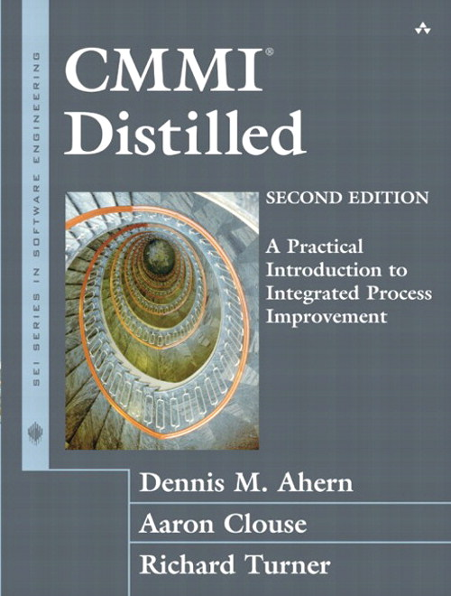
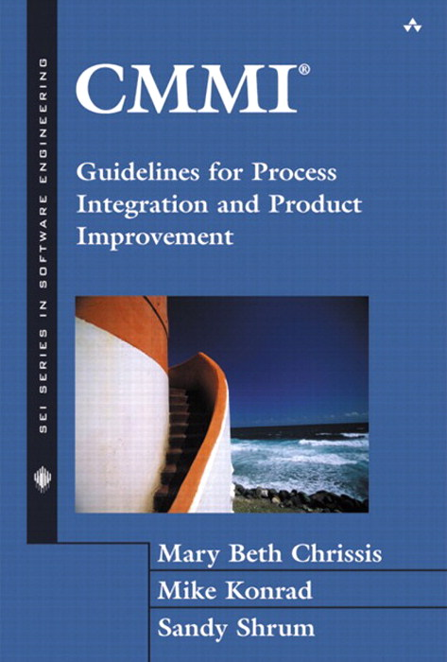
Further Reading

Slide 66
Thank you

